Slide 1
CSE 601: Distributed Systems
Toukir Ahammed

Slide 2
Introduction to Distributed System

Slide 3
What is a distributed system?
Hardware or software components located at networked computers that communicate or coordinate their actions only by passing messages.
-Coulouris, Dollimore, Kindberg, Blair

Slide 4
What is a distributed system?
A collection of autonomous computing elements, connected by a network, which appear to its users as a single coherent system.
-Steen and Tanenbaum

Slide 5
What is a distributed system?
A system in which components located on networked computers communicate and coordinate their actions by passing messages. The components interact with each other in order to achieve a common goal.
- Wikipedia

Slide 6
What is a distributed system?
Independent components or elements
(software processes or any piece of hardware used to run a process, store data, etc.)

Slide 7
What is a distributed system?
Independent components or elements that are connected by a network.

Slide 8
What is a distributed system?
Independent components or elements that are connected by a network and communicate by passing message.

Slide 9
What is a distributed system?
Independent components or elements that are connected by a network and communicate by passing message to achieve common goal, appearing as a single coherent system.

Slide 10
What is a distributed system?
A distributed system is one in which the failure of a computer you didn't even know existed can render your own computer unusable.
- Leslie Lamport

Slide 11
What is a distributed system?
More definitions:
“A collection of independent computers that appears to its users as a single coherent system.”
“A computing environment in which various components are spread across multiple nodes (computer, phone, car, robot or other computing devices) on a network trying to achieve some task together.”

Slide 12
Examples of distributed systems
Machine learning (for compute)
P2P file sharing (high availability, share large files, piracy)
Google search engine (for storage and bandwidth)
Facebook (for storage and bandwidth)
Black hole image (distributed observation)
IOT (Sensors on a network)
Blockchain (decentralized record of transactions) etc.

Slide 13
Examples of distributed systems
World Wide Web
A cluster of nodes on the cloud (AWS, Azure, GCP)
Multi-player games
BitTorrent
Online banking
…………

Slide 14
A typical portion of the Internet
intranet
☎
ISP
☎
☎
☎
backbone
satellite link
desktop computer:
server:
network link:
Instructor’s Guide for Coulouris, Dollimore, Kindberg and Blair, Distributed Systems: Concepts and Design Edn. 5 © Pearson Education 2012

Slide 15
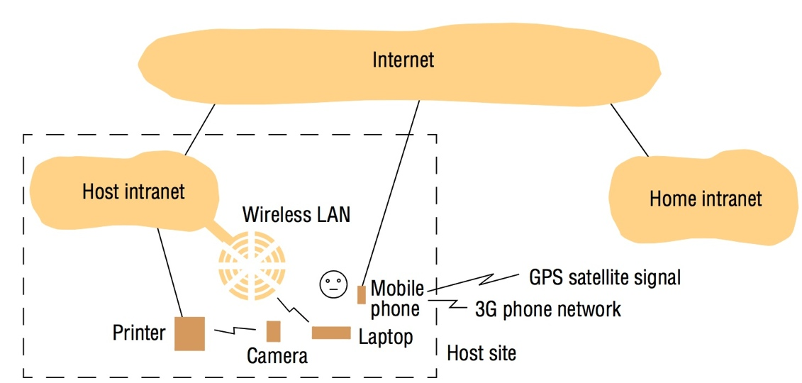
Portable and handheld devices in a distributed system
Instructor’s Guide for Coulouris, Dollimore, Kindberg and Blair, Distributed Systems: Concepts and Design Edn. 5 © Pearson Education 2012

Slide 16
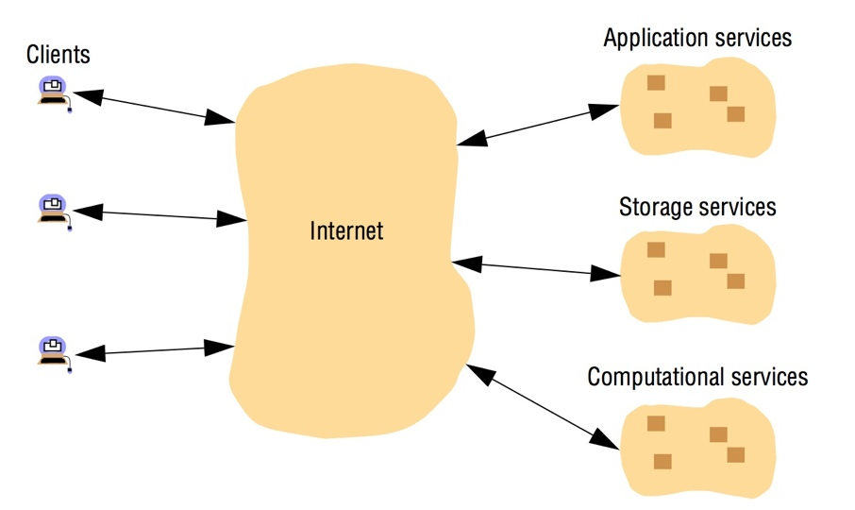
Cloud computing
Instructor’s Guide for Coulouris, Dollimore, Kindberg and Blair, Distributed Systems: Concepts and Design Edn. 5 © Pearson Education 2012

Slide 17
Why distributed systems?
Nature of the application
Multiplayer games, P2P file sharing, client requesting a service.
Availability despite unreliable components
A service shouldn’t fail when one computer does.
Conquer geographic separation
A web request in India is faster served by a server in India than by a server in US.
Scale up capacity
More CPU cycles, more memory, more storage, etc.
Customize computers for specific tasks
E.g. for storage, email, backup.

Slide 18
Why make a system distributed?
It’s inherently distributed:
e.g. sending a message from your mobile phone to your friend’s phone
For better reliability:
even if one node fails, the system as a whole keeps functioning
For better performance:
get data from a nearby node rather than one halfway round the world
To solve bigger problems:
e.g. huge amounts of data, can’t fit on one machine

Slide 19
Why NOT make a system distributed?
The trouble with distributed systems:
Communication may fail (and we might not even know it has failed).
Processes may crash (and we might not know).
All of this may happen non-deterministically.
Fault tolerance: we want the system as a whole to continue working, even when some parts are faulty.
This is hard.
Writing a program to run on a single computer is comparatively easy?!

Slide 20
Challenging properties
Multiple computers
Concurrent execution.
Independent failure.
Autonomous administration.
Heterogeneous.
Large numbers.
Heterogeneity (variety and difference):
the differences that arise in networks, programming languages, hardware, operating systems and differences in software implementation.

Slide 21
Challenging properties
Networked communication
Asynchronous
Unreliable
Insecure

Slide 22
Challenging properties
Common goal
Consistency
Transparency
system that is able to present itself to users and applications as if it were only a single computer system is said to be transparent.

Slide 23
Advantages of Distributed Systems
Scalability:
Distributed systems are made on default to be scalable.
Whenever there is an increase in workload, users can add more workstations.
There is no need to upgrade a single system.
Moreover, no any restrictions are placed on the number of machines.

Slide 24
Advantages of Distributed Systems
Reliability:
Distributed systems are far more reliable than single systems in terms of failures.
Even in the case of a single node malfunctioning, it does not pose problems to the remaining servers. Other nodes can continue to function fine.

Slide 25
Advantages of Distributed Systems
Low Latency(বিলম্ব):
Since users can have a node in multiple geographical locations, distributed systems allow the traffic to hit a node that’s closest, resulting in low latency and better performance.

Slide 26
Advantages of Distributed Systems
Efficiency:
Distributed systems allow breaking complex problems/data into smaller pieces and have multiple computers work on them in parallel, which can help cut down on the time needed to solve/compute those problems.

Slide 27
Pitfalls when Developing Distributed Systems
False assumptions made by first time developer:
The network is reliable.
The network is secure.
The network is homogeneous.
The topology does not change.
Latency is zero.
Bandwidth is infinite.
Transport cost is zero.
There is one administrator.

Slide 28
Distributed versus decentralized systems
centralized
decentralized
distributed

Slide 29
Distributed versus decentralized systems
Decentralized is still distributed in the technical sense, but the whole decentralized systems is not owned by one actor. No one company can own a decentralized system, otherwise it wouldn’t be decentralized anymore.
This means that most systems we will go over today can be thought of as distributed centralized systems — and that is what they’re made to be.

